Slide 1
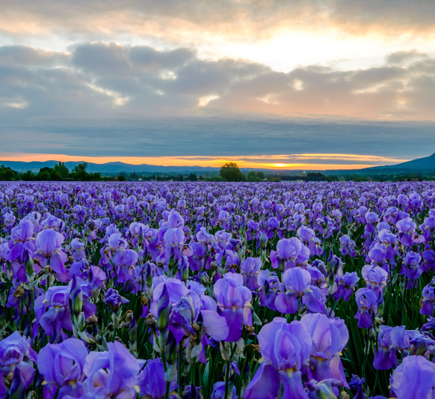
IN-DEPTH ANALYSIS ON IRIS FLOWER
IDENTIFYING IRIS FLOWER TYPES BASED ON THEIR LENGTH and WIDTH of PETAL and SEPAL
INFO8676
GROUP – 8
Team Members :
SATISH SINGAMANENI JAY PATEL HARSH VYAS

Slide 2
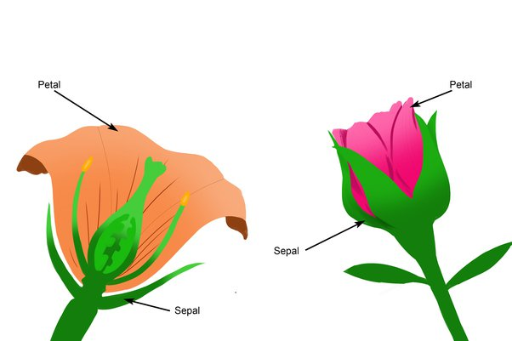
SUMMARY
Dr. Reddy’s is a prominent leader in pharmaceutical company which manufacturers essential oils for therapeutic benefit
While making oils they are unable to identify which flower type they are using in manufacturing process because of same flower colors
They use multiple beneficial IRIS flowers (Setosa , Versicolor , Virginica )
BA team is assigned to identify the flower type based on petal and sepal length
Providing solutions on how much oil can be extracted based on the weight and widths of petal and sepal

Slide 3
ANALYSIS APPROACH
1) We have identified the IRIS flower historical data set
2) Data set contains information about different flower types(Setosa , Versicolor , Virginica )
3) Individual length and width of petal and sepal are noted
4) Analyse the data and make assumptions and infographs
5) Make conclusions on how to identify flower belongs to which type of category

Slide 4
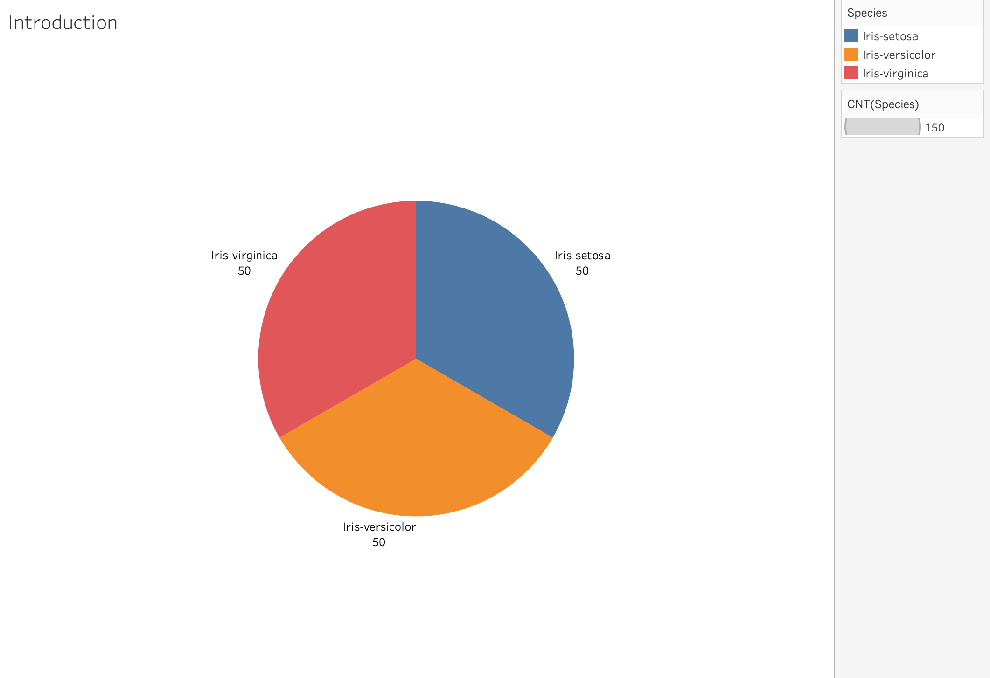
DATA SET
Data set contains equivalent data of all the three species of IRIS flower because a minimum of 50 flowers contribute to a 10ML oil.
All the data set contains flowers with different variances in length and width of petal and sepal
Length and width of flower varies from a minimum of 1cm to 8cm in length.

Slide 5
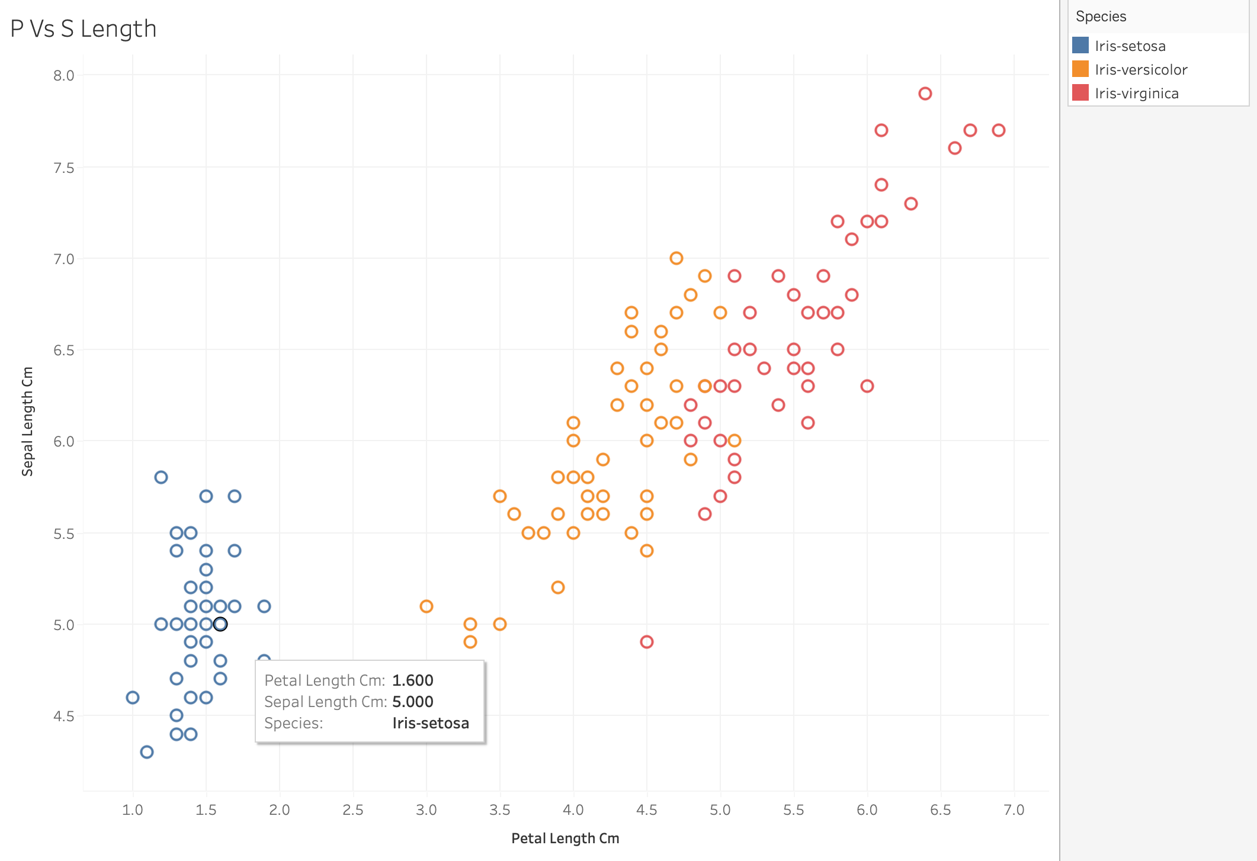
KEY INSIGHTS – (1)
If the Petal length is less than 4.7 CM that belongs to IRIS-SETOSA family
Sepal length is between 0 and 6 cm and petal length is between 1 and 2 cm, the iris flower is classified as Iris-setosa.
If petal length is between 3 and 5 cm, the iris flower is classified as Iris-versicolor.
If the iris flower doesn't fall into the above criteria, it is classified as Iris-virginica.

Slide 6
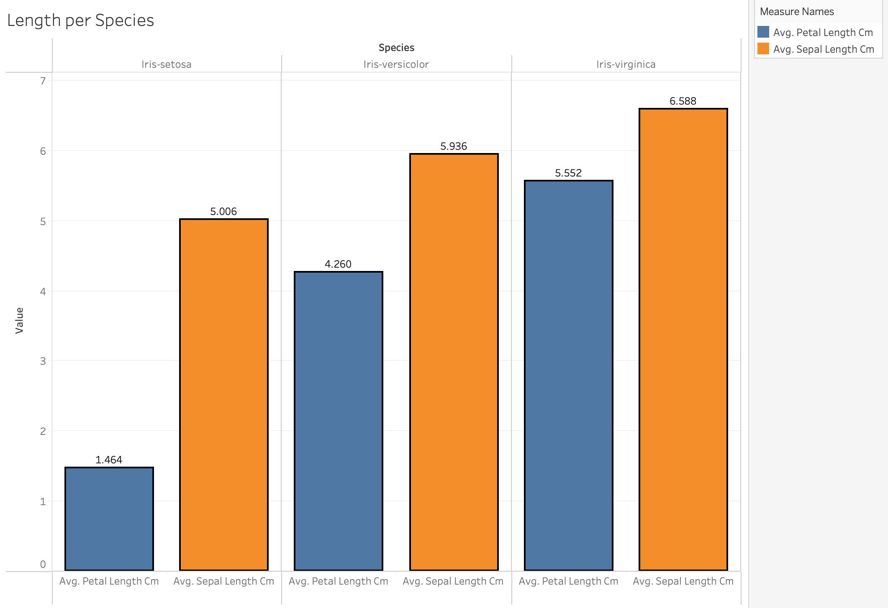
KEY INSIGHTS – (2)
The average sepal length varies among the different species. Iris-virginica has the longest average sepal length (6.588 cm), followed by Iris-versicolor (5.936 cm) and Iris-setosa (5.006 cm).
The average petal length also varies across the species. Iris-virginica has the longest average petal length (5.552 cm), followed by Iris-versicolor (4.26 cm)
IRIS setosa has less Avg petal length of (1.464 cm)

Slide 7
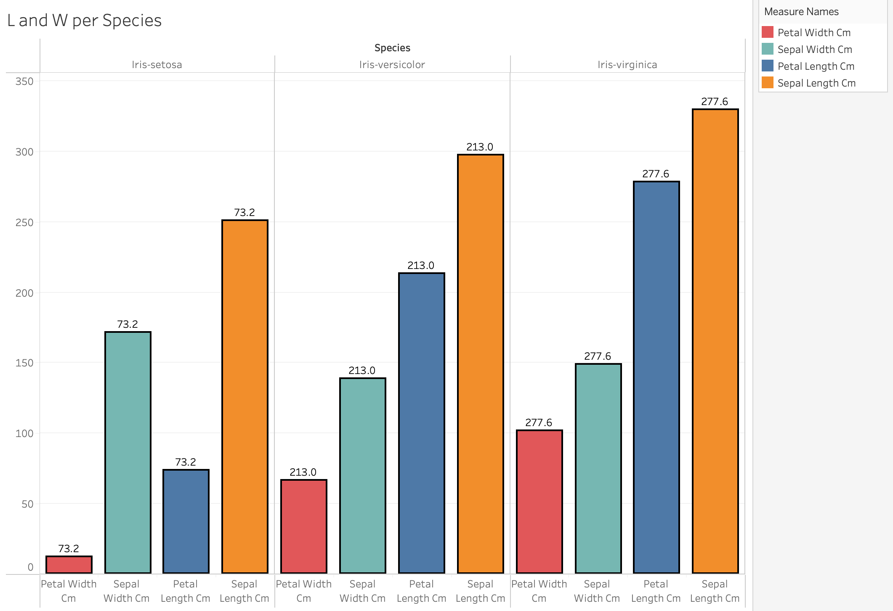
KEY INSIGHTS – (3)
Among the three species, Iris-virginica consistently has the highest measurements for both sepal length (329.4) and sepal width (277.6). Iris-versicolor follows, while Iris-setosa has the lowest measurements for both parameters
The petal width measurements show variability across species. Iris-setosa has the highest petal width (73.2), Iris-versicolor has an intermediate value (213), and Iris-virginica has the lowest (277.6)

Slide 8
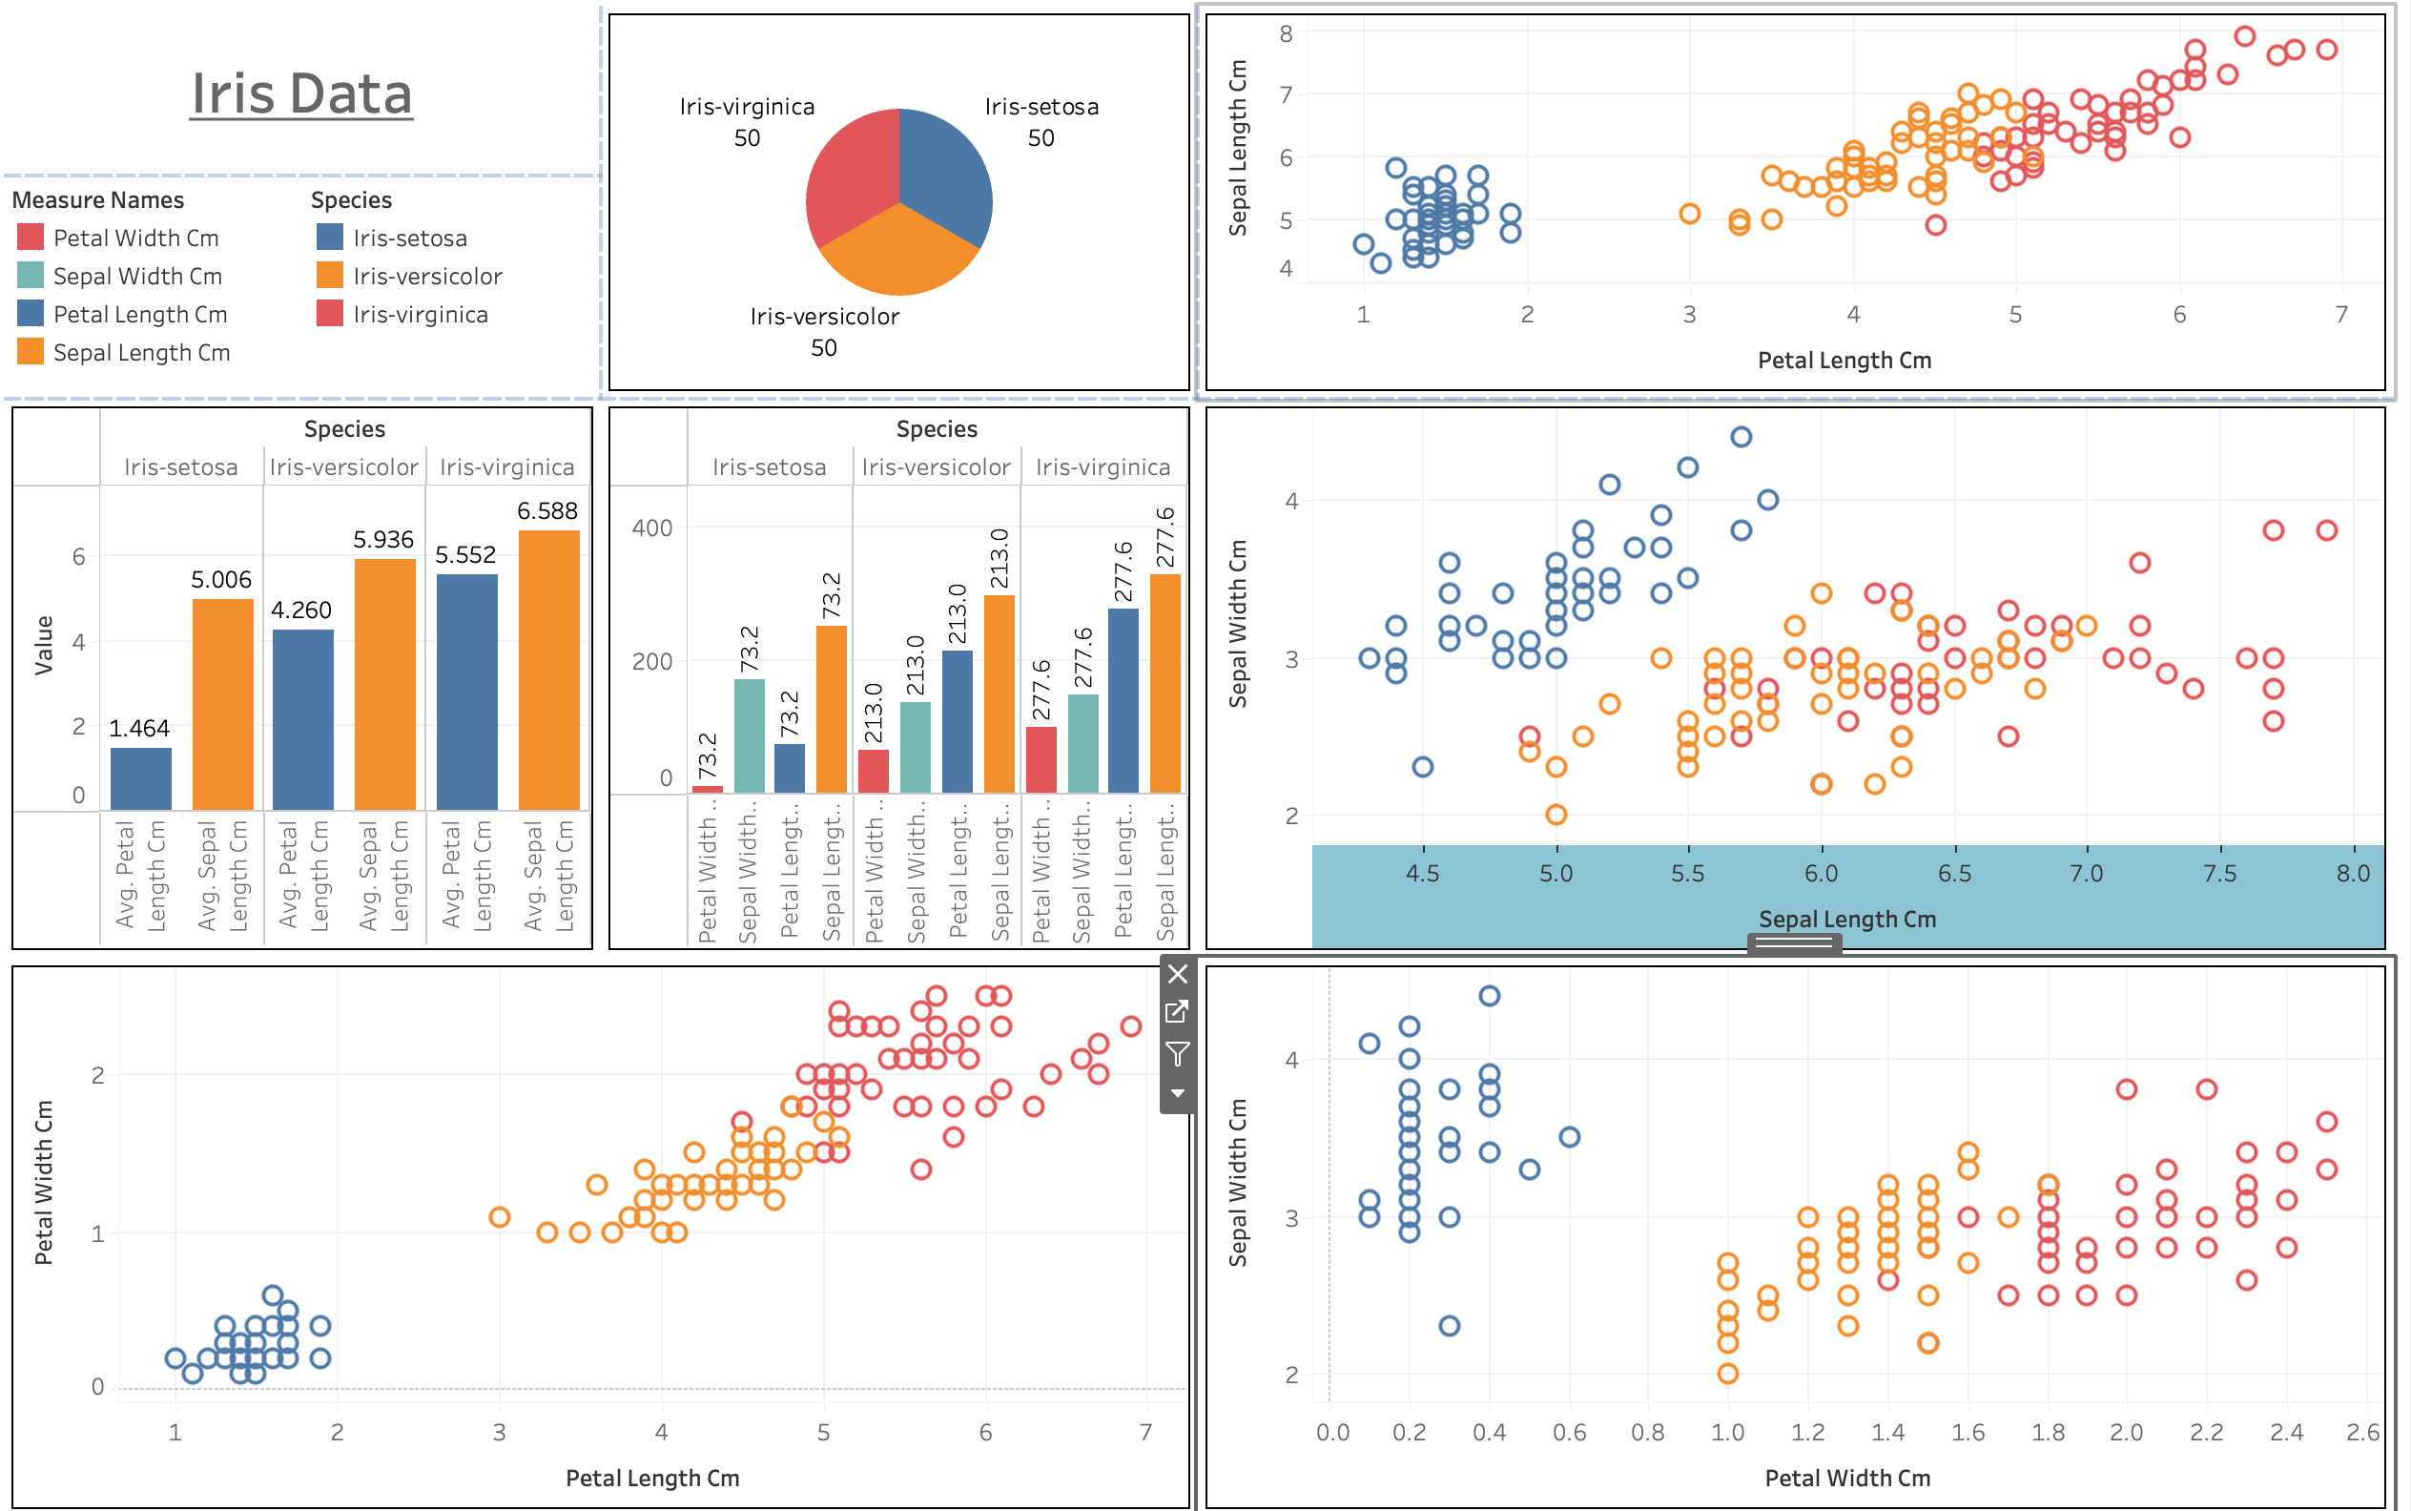
TABLEAU DASHBOARD

Slide 9
RECOMMENDATIONS
Based on the analysis carried out, Dr. Reddy’s will be able to achieve the below conclusions that we have inspected from the data
Identification of Flower Types and able to differentiate the IRIS flower variants
Differentiating IRIS setosa variant
Sepal Measurements variance can be addressed
Quality Control and Assurance

Slide 10
THANK YOU

